Slide 1
Deliverable 1

Slide 2
Project Idea Table (Summary)
Project Ideas | Description
Arya Khosravi: Music App | App where the user can create music out of sounds, audio files and modify the audio samples
Theodore Georgiou: Car simulator | Realistic car physics simulator that allows for 2 player races and physics values to be displayed
Alexander Little: Sign Language Translator | Translate sign language in real-time using the user’s camera.
Ahmet Yusuf Yildirim: 3D Terrain Generation | Using DEM maps to create an interactable 3D terrain

Slide 3
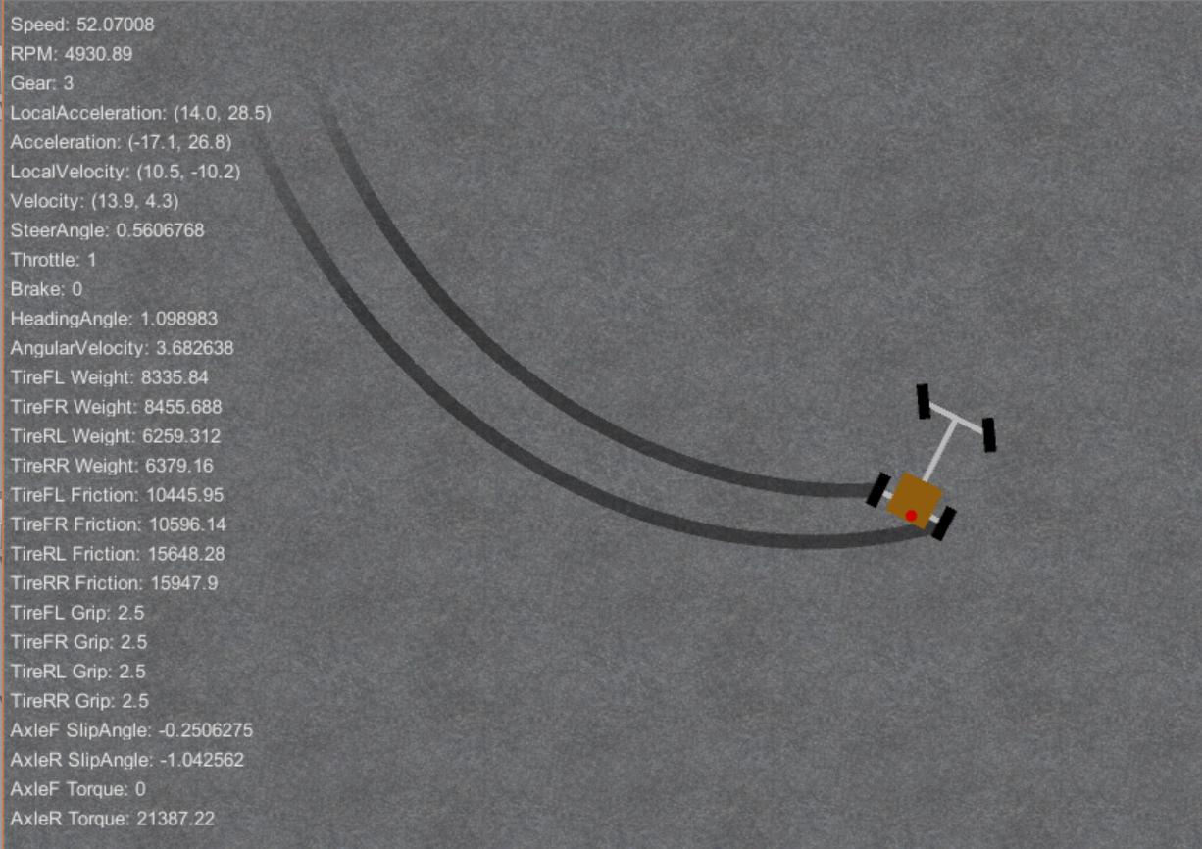
Car simulator
Involves physics learned in Mechanics (friction, torque, etc.)
Users can control the movement of a car on a selected track
The energy of the car will be displayed
The user can select type of vehicle
Two users can drive at the same time and the best time can be saved
HUD showing speed and other important physics values can be displayed
Simulates engine performance (horsepower and torque)
Gearbox simulation (automatic/manual)
Basic aero physics (downforce for race cars)

Slide 4
Sign Language Translator
(Image Recognition)
Involves complex mathematical and computational concepts (image processing, neural networks, pattern recognition)
Uses machine learning to recognize and interpret sign language gestures in real time
Displays the translated text or speak verbally using text-to-speech
Can incorporate physics of motion tracking to improve hand gesture detection
Would use OpenCV library as building the program from scratch is not feasible
However, OpenCV already provides too many features.

Slide 5
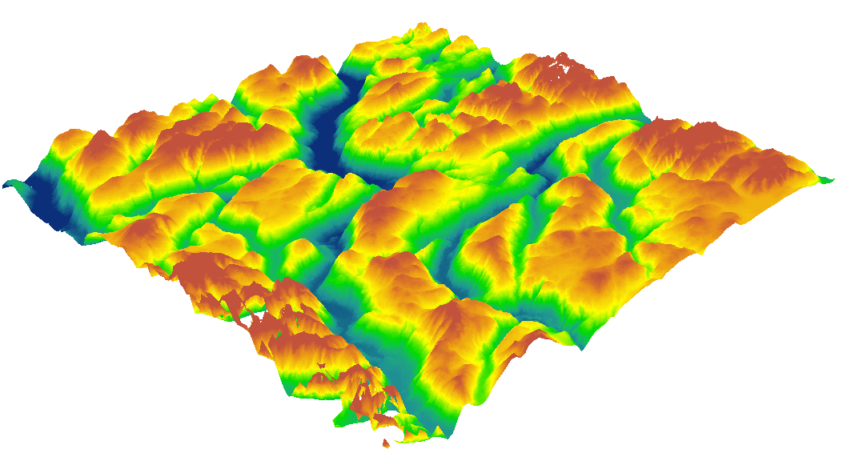
3D Mesh creator based on Google Maps DEM (Digital Elevation Model)
Using multiple APIs to get the DEM map of a chosen area on earth (Google maps)
Related to geophysics for studying earthquakes, erosion, and gravity variations.
Analyzing the DEM map pixel by pixel until we have a 2D array that contains the height of each pixel
Connecting these points with the help of an algorithm and creating faces between those points (Dijkstra or A*).
Generating 3D elements such as rivers (fluids) and trees.
Generating shadows based on the light source (sun).
Allowing user interaction with the terrain (like Blender meshes).
Using bezier curves to smooth out the model.
Not chosen due to complexity

Slide 6
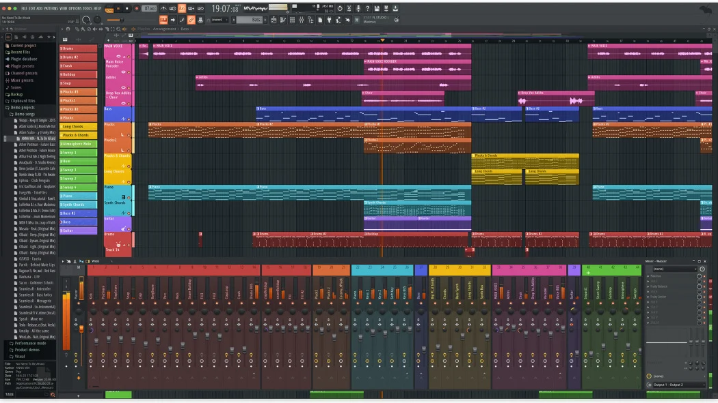
Chosen Idea: Music Creation App
Involves using complex fourier transformation algorithms to deconstruct each sound wave in a more complex sound wave
Use of different filtering algorithms to vary audio pitch, modify audio files, equalizers and amplitude
Implements different sound waves such as sin waves, square waves, saw waves, etc
Used to make music by ordinary people and professionals
GUI contains the audio files and tracks, as well as system usage, visualizers and a file management system
Hardware integration for midi keyboards and regular keyboards
Ability to record your own audio in app

Slide 7
Our choice and why
Why? Audio processing/modification is relatively easy with fft (fast fourier transform) algorithms, as such is the algorithms for eq management, pitch adjust and other functions. Implementing such algorithms should take no more than 2 weeks max for each one.
Adding keyboard and audio device implementation is also easy, with or without libraries. This and a live audio recording system will allow seamless audio integration into a music track. This should take less than a week in total.
The GUI is quite simple as well. The most difficult part is adding a snap feature and creating a distinct GUI from other music apps.
Audio cutting and modification is also easy considering it consists of removing data points from the imported file.
All in all, the project is more feasible than the other options for its simplicity and its uniqueness.

Slide 8
Inputs/Outputs
Inputs: computer keyboard, midi controllers (maybe), mouse, audio files, live audio recording, synthesized sounds, instruments. Inputs will be done with sliders, menu buttons, knobs and custom GUI elements
Outputs: music files/saved files, visualization, modified audio files (voice changer), stereo or mono output

Slide 9
Individual Parts
Parts that need to be implemented:
-Note Placement, Multiple Tracks, Audio Channels, Audio Synthesizer, BPM, Different Instruments, Custom Audio Files, Audio Recording, Pitch Modification, Sound Equalizer, Audio File Manipulation, 3D Visualizer
At this time, the task distribution is not set. We plan on splitting the project up in quarters (subject to change). This will be done in Deliverable 2.

Slide 10
Bibliography
Fl Studio Picture (by PCMag): https://www.pcmag.com/reviews/image-line-fl-studio
DEM map Picture (by GISGeography): https://gisgeography.com/free-global-dem-data-sources/
2D car simulator (by jongallat): https://github.com/jongallant/CarSimulator

